Slide 1
AM & PM Heights
A Regression Comparison

Slide 2
Results

Slide 3
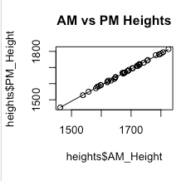
The Specific Data Finds (for those statistically inclined)
The data definitely created a linear pattern. With the PM heights being found using the formula y=-6.945 x +1.01 with x being the independent variable. Meaning for every increase by 1 unit in the AM height, the PM height decreases by 6.945 units.

Slide 4
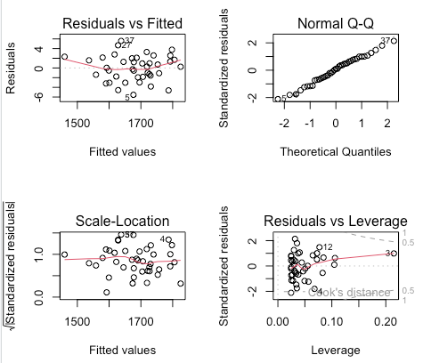
The Specific Data Finds (for those statistically inclined)
The test for homoscedasticity revealed these graphs. The residuals vs fitted graph looks okay, but the Residuals vs Leverage graph looks quite clustered on the left.
Checked with Breush-Pagan test
P value revealed it was not significant, so the assumption is met!

Slide 5
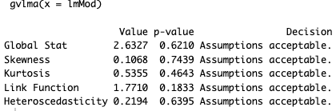
Continued testing
Non-Constant Variance Test also revealed a p-value that was not significant, so this assumption was met.
Test for Homogeneity of Variance from the graphs on the previous slide did not show a cone or triangular pattern, so this assumption is met.
Double checking with gvlma, we confirmed all assumptions have indeed been met.

Slide 6
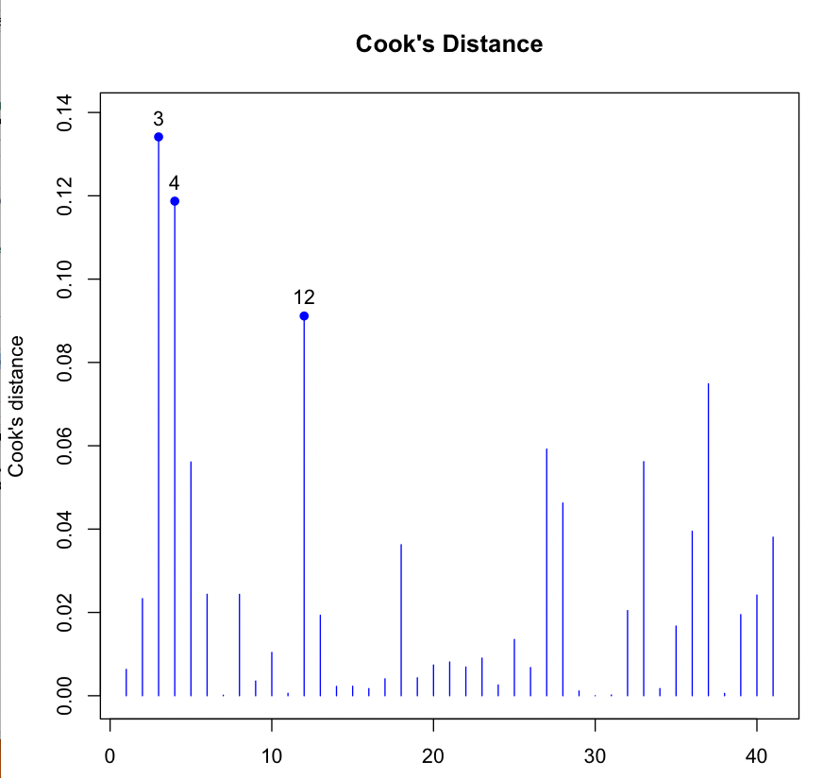
Looking for Outliers
Cook’s shows 3, 4 and 12 might possibly be outliers in x. It also showed there was an outlier in y.
For outliers in x and y space, I got 2, 3, and 11. Created a new model without outliers and compared the residuals, Both showed the linear model explained about 99% of the data.

